Slide 2
250+
VIRTUAL
PRESENTATIONS
ALL EVENTS FREE
Talks with global experts
Experiment-along activities
Demonstrations
Virtual tours
Citizen science activities
And so much more!
Visit the virtual Expo Days on 3 Saturdays in April
April 3, 10, and 17 (register for free on the MSU Science Festival website)
SCIENCEFESTIVAL.MSU.EDU

Slide 3
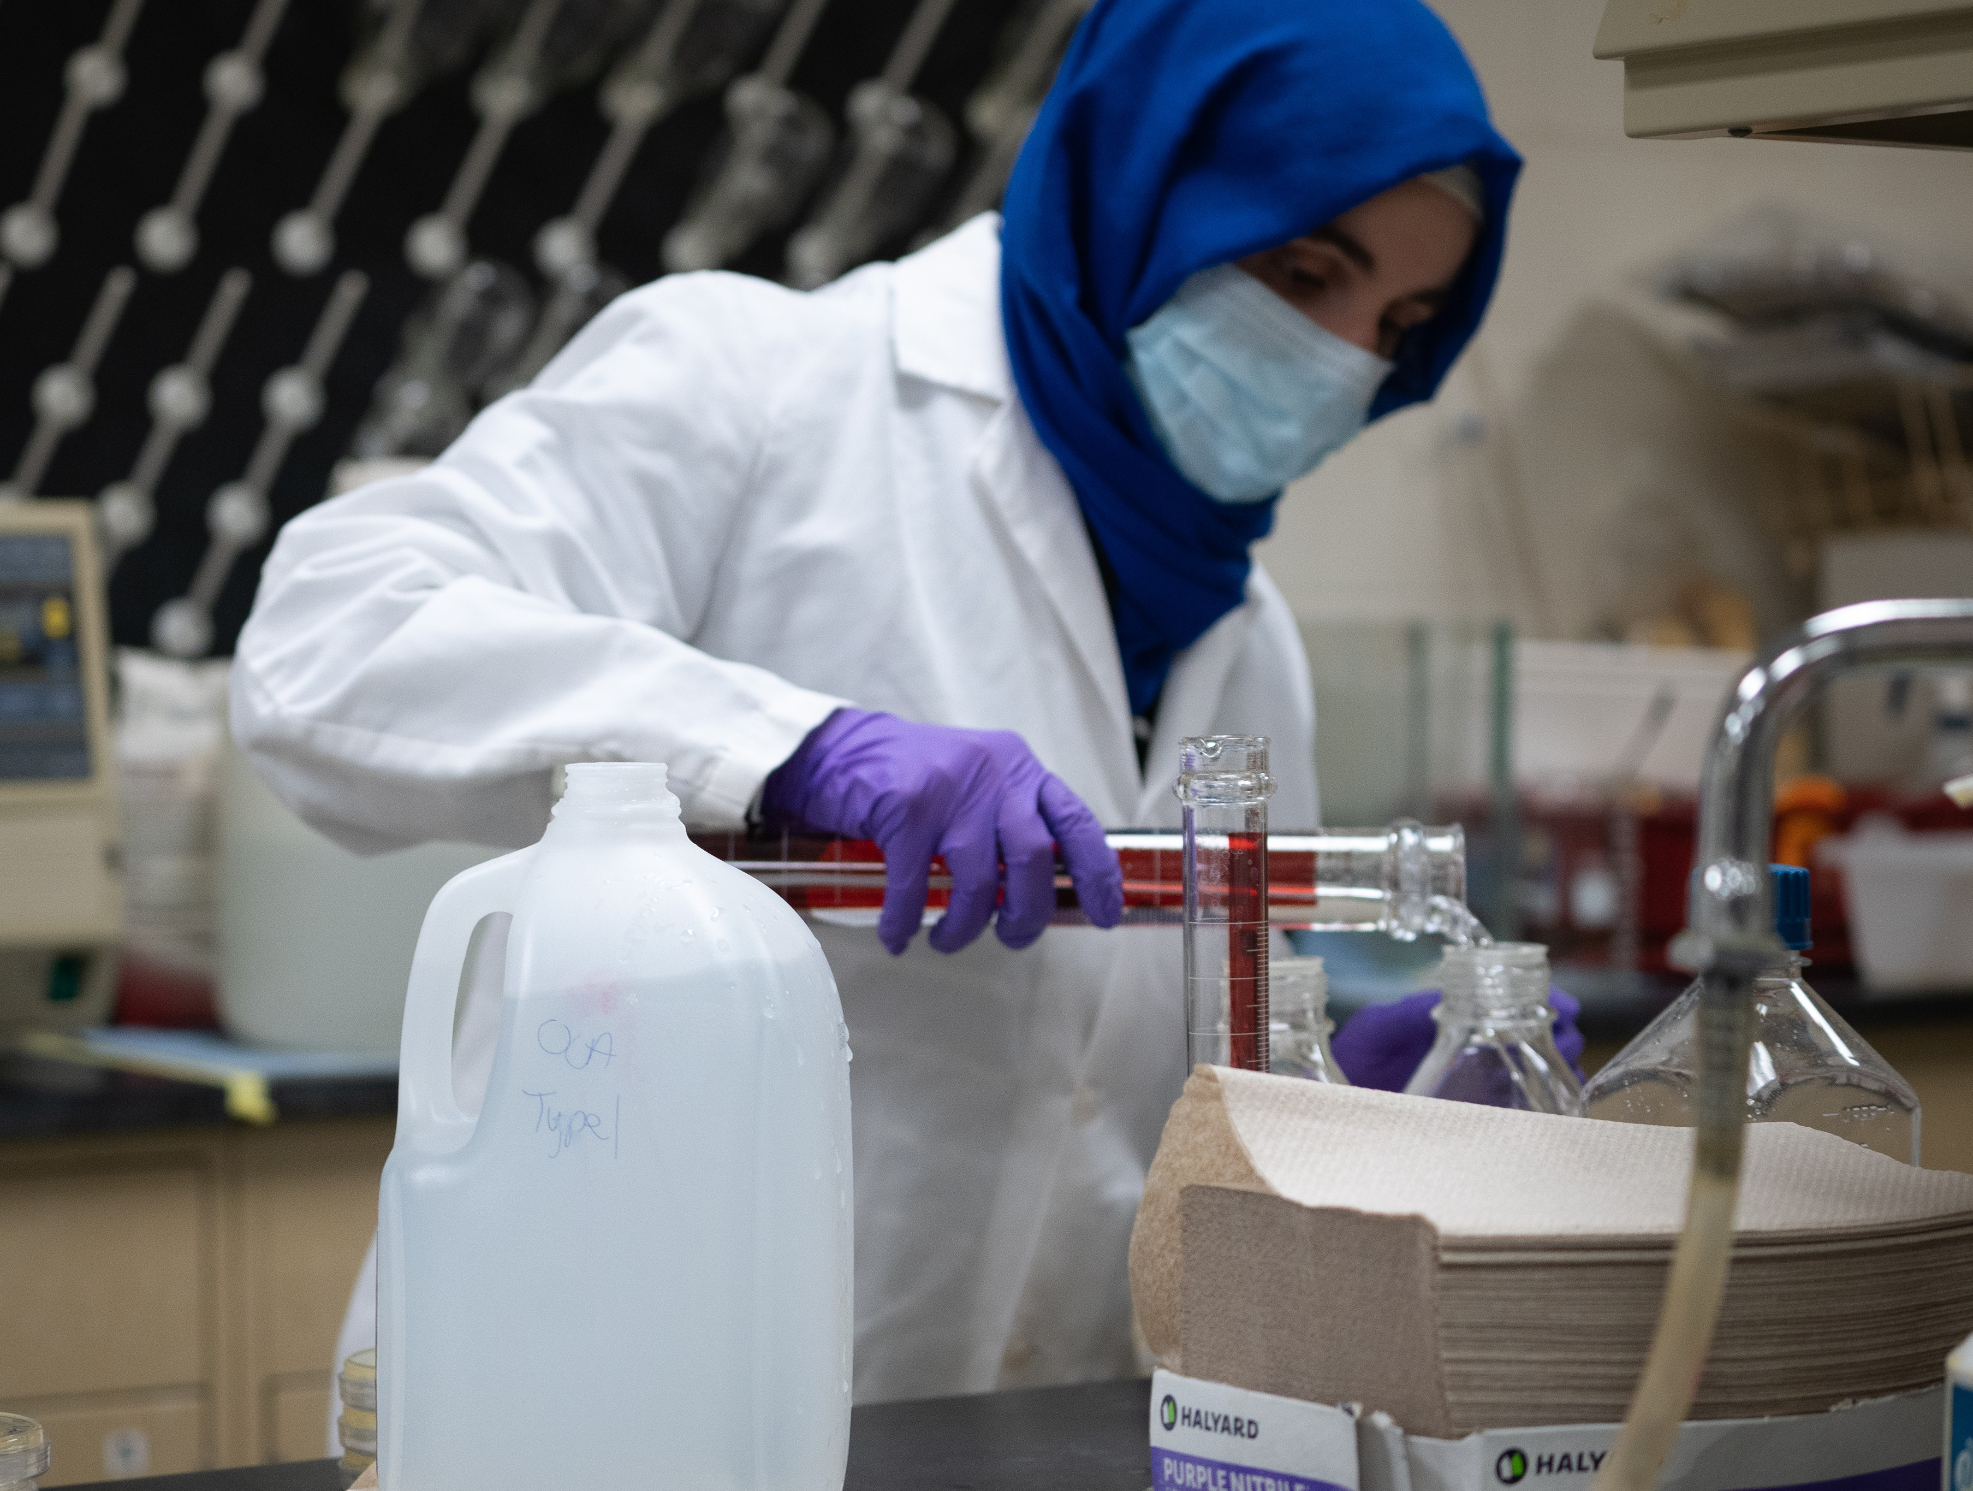
K-12 School Programs
Annually in March and April
“Ask a Scientist” Model “ virtual presentations
Potentially on campus and in-school for 2022
sciencefestival.msu.edu

